Slide 1



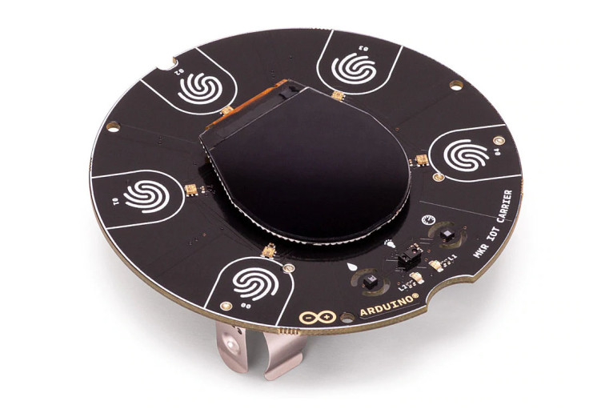














Remote Work Clerk
PHP Scripts running on local server are executed to read and write data to MySQL from Arduino sensors
Wifi
Arduino uses inbuilt Gesture Sensor, Temperature Sensor and External Sound Sensor, and uses LED lights to show whether monitoring is on or not
When the sound monitoring is on, and a sound is triggered, Alexa will notify the user in the kitchen via ThingSpeak, IFTTT, and VoiceMonkey
Uses Blynk to turn on and off sound monitoring (alternative to gesture monitor) as well as monitoring the temperature and sending email and push notification when temperature goes too high

